Slide 1
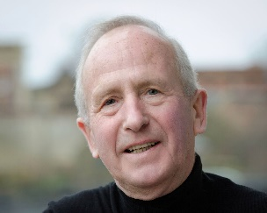
What experiments can tell us about human economic behaviour
John Hey
The first in a course of lectures given at the University of Economics, Ho Chi Minh City
Lecture 1, 20th July 2022
John Hey

Slide 2
Who am I?
I am John Hey
I am at the University of York and have been there for some 48 years. I am now Emeritus Professor of Economics and Statistics.
I am Director of EXEC, the Centre for Experimental Economics at the University of York.
I have been running experiments for some 35 years, on individual choice, game theory and markets.
I have created a page for this course, which I will add to as the course proceeds.
Much depends on how I can help you.

Slide 3
What you can do for me
After this lecture, could you send me an email stating:
Your first name
Your last name
Your email address
Your status and background
What your research interests are
Whether you have done experiments and what kind of experiment you are interested in doing.
Any other information that may help me construct this course in the best way for you.
I will repeat this slide at the end of the lecture.

Slide 4
A question for you
What would you think about a scientist who wants to test the efficiency of a drug, who collects data on the sale of the drug (in some town or region or country) and data on the incidence of the problem that the drug is supposed to cure (in that town or region or country), and statistically looks at the relationship between the latter and the former?

Slide 5
A second question
What would you think about a scientist who wants to test whether a new brand of tyres is safer than the old one, who collects data on the sales of the tyre (in some town or region or country) and data on motor accidents (in that town or region or country) and statistically looks at the relationship between the latter and the former?

Slide 6
A final question
What would you think about a scientist who wants to test whether raising interest rates increases saving, who collects data on interest rates over time in some country and saving in that country, and statistically looks at the relationship between the latter and the former?

Slide 7
The answers in each case?
Not a lot.
In the first two cases the scientist would conduct a laboratory experiment.
Keeping all other factors (not of interest) fixed.
Why cannot economists do the same?
Well, experimental economists do.

Slide 8
Economics
Economics is theory driven and based on axioms.
Economics has strong notions about rationality, particularly about rational expectations and dynamic behaviour.
Central to economics is equilibrium.
Economics mostly assumes that people are self-interested.
Economics usually relies on indirect tests of theories (using data from the economy with many uncontrolled factors) rather than direct experimental tests under controlled conditions.

Slide 9
Experimental economists’ claims
All theory is built on top of individuals (usually maximising their own self-interest).
Theory does not specify which individuals.
We can test/investigate most economic theories, including macro models and those of international trade ‒ as these usually involve a small number of (representative) agents.
Experiments enable us to find what is wrong with existing theories and to suggest new ones.
This appears to us to be scientific progress.
Let me start with an example.

Slide 10
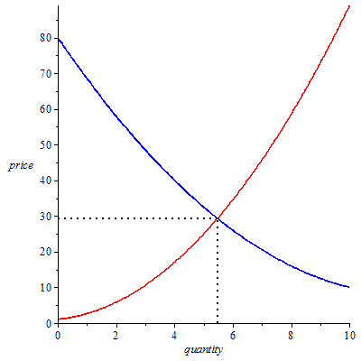
equilibrium

Slide 11
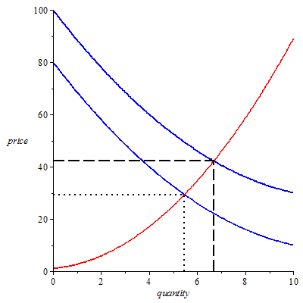
Comparative statics

Slide 12
What does the theory say?
That equilibrium exists.
It is an equilibrium in the sense that once we are there, no individual can gain by changing his or her decision.
That if there is an upwards shift in the demand curve then the equilibrium price and quantity increase.
Does it say that the equilibrium will be attained?
No.
Does it say that the price will move upwards?
No.
It cannot – because there is no-one to set the price.

Slide 13
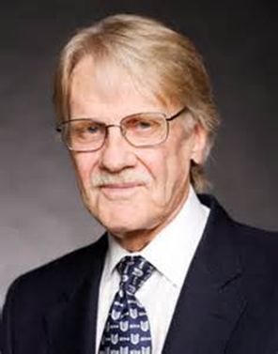
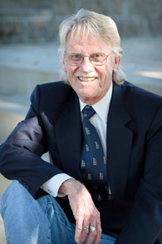
So why not see what happens?
We need to give the agents the ability to announce prices (not necessarily set them).
(We may be looking for an Austrian Economics concept of the emergence of spontaneous order.)
This is what Vernon Smith (Nobel Prize Winner in 2002) did in his path- breaking experiments in the 1960’s.
We need to give incentives to the
agents/subjects.

Slide 14
How we set up a market experiment
How do we get people to act as potential buyers?
How do we get people to act as potential sellers?
How is the price formed?
What might the experiment tell us about the theory?

Slide 15
demanders
What is a demand curve?
What are reservation prices?
What does a demand curve for a discrete good look like?
Suppose an individual wants to buy at most one unit of a discrete good and his/her reservation price for the one unit is 6. What does his/her demand curve look like? what does it tell us?

Slide 16
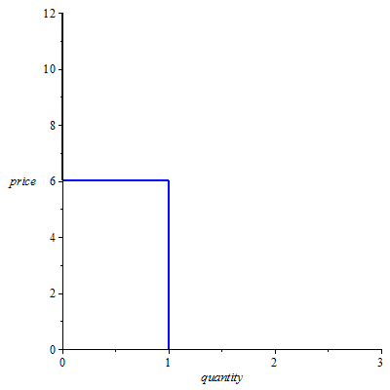
Demand curve of this demander
Suppose there are five demanders, each wanting to buy at most one unit, with reservation prices 10, 9, 6, 5 and 2. What does their aggregate demand curve look like?

Slide 17
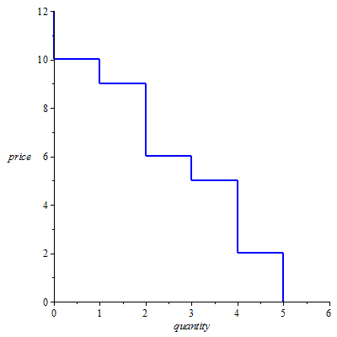
Aggregate demand curve

Slide 18
Inducing subjects to act as demanders
How do we do this?
We tell each subject that they are potential buyers of a hypothetical good that will be traded in the experiment, and that if they buy they will be paid by the experimenter a given sum of money (their reservation value – but we do not use this word) and that they will have to pay the price agreed out of this money.
An obvious incentive mechanism. They get their surplus.
We can obviously generalise this.

Slide 19
suppliers
What is a supply curve?
What are reservation prices?
What does a supply curve for a discrete good look like?
Suppose an individual wants to sell at most one unit of a discrete good and his/her reservation price for the one unit is 5. What does his/her supply curve look like?

Slide 20
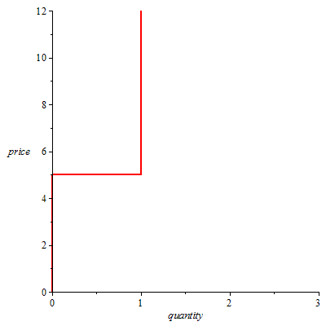
supply curve of this supplier
Suppose there are five suppliers, each wanting to sell at most one unit, with reservation prices 1, 4, 5, 7 and 9. What does their aggregate supply curve look like?

Slide 21
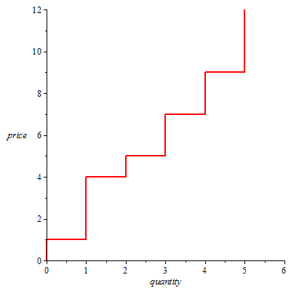
Aggregate supply curve

Slide 22
Inducing subjects to act as suppliers
How do we do this?
We tell each subject that they are potential sellers of a hypothetical good that will be traded in the experiment, and that if they sell they will receive the price agreed and that they will have to pay to the experimenter a given sum of money (their reservation value – but we do not use this word) out of this money.
An obvious incentive mechanism. They get their surplus.
We can obviously generalise this.

Slide 23
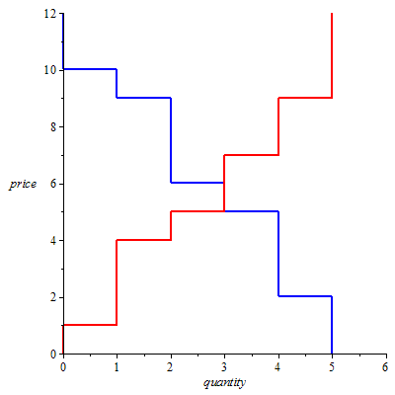
The market

Slide 24
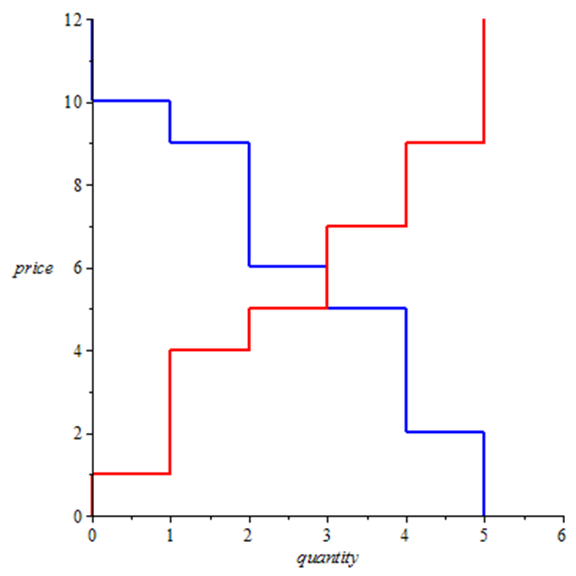
Who trades?
Do all in the competitive equilibrium?
Can all outside competitive equilibrium?
Why do we like competitive equilibrium?

Slide 25
Trading mechanisms?
In the theory? In the real world?
I list some here.
Double Auction
Walrasian Auctioneer
Clearing House
Bilateral Bargaining
Sellers set prices
Buyers set prices
…

Slide 26
Double auction
The market period lasts a pre-determined time.
At any point buyers can make bids: a price at which they are willing to buy.
At any point sellers can make asks: a price at which they are willing to sell.
Bids and asks are posted.
At any time a buyer can accept a posted ask of a seller – and then a trade takes place at that price.
At any time a seller can accept a posted bid of a seller – and then a trade takes place at that price.
There is no communication between the subjects and they do not know each others reservation prices.

Slide 27
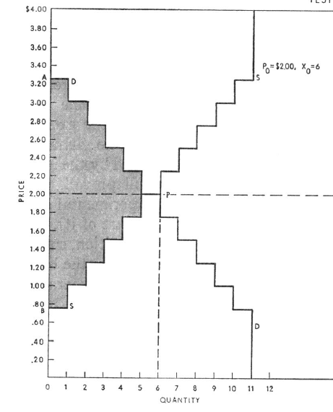
The classic example from smith 1962
11 potential buyers with reservation prices from 3.25 to 0.75.
11 potential sellers with reservation prices from 0.75 to 3.25.
Equilibrium price 2.00.

Slide 28
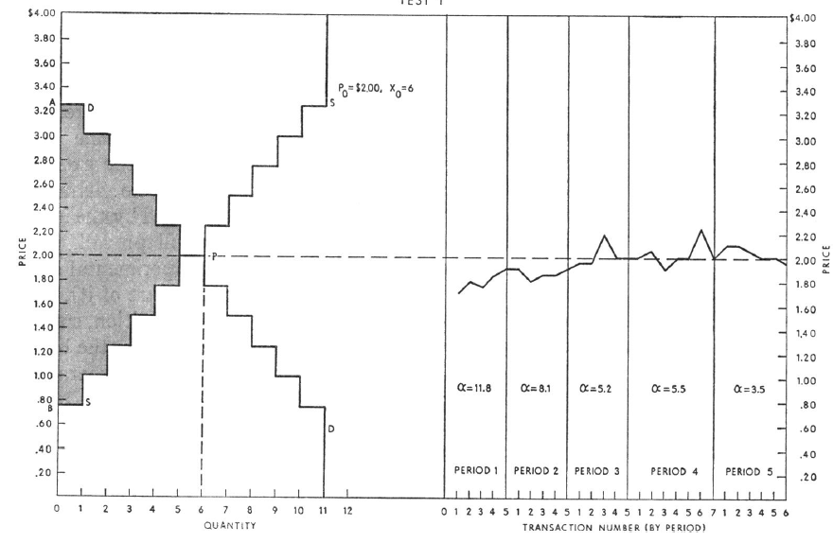
What happened in period 1?

Slide 29
What happened in period 2?

Slide 30
What happened in period 3?

Slide 31
What happened in period 4?

Slide 32
What happened in period 5?
Magic!?

Slide 33
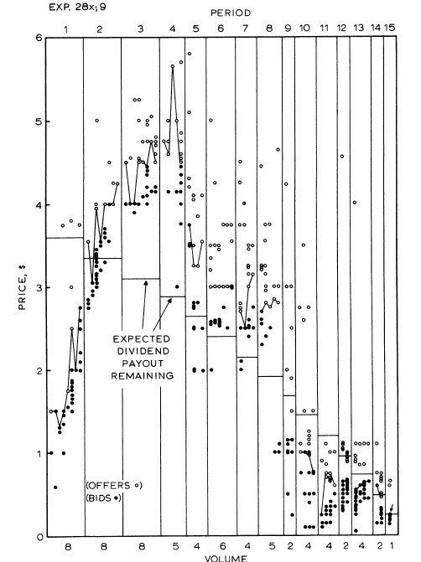
The theorists are vindicated!
But…
A repeated market – repeated 15 times.
From Smith, Suchanek and Williams 1998
All subjects endowed at the start with units of an asset that paid a random dividend with mean 24 cents each period. Endowed also with ultimately worthless experimental money with which to trade.
We observe a bubble and a crash.
What was happening?

Slide 34
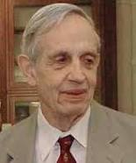
Game theory
Again here theorists are obsessed with equilibrium – here the Nash Equilibrium…
… in which everybody is doing the best for themselves given what everyone else is doing.
It is an equilibrium in the sense that once we are there, no individual can gain by changing his or her decision.
But is it attained?
Only experiments can tell us.

Slide 35
A symmetric game
The two players move simultaneously.
First number – payoff to A; second - payoff to B.
What would you do?
What does the theory predict?
How does one set up an experiment to test it?
The theory works! Experiments with real money prove it.
 |  | Player B B
 |  | 1 | 2
Player A | 1 | £10, £10 | £12, £0
 | 2 | £0, £12 | £11, £11

Slide 36
But…
The two players move simultaneously
First number – payoff to A; second - payoff to B.
What would you do?
What does the theory predict?
How does one set up an experiment to test it?
The theory does not work! Experiments with real money prove it.
 |  | Player B B
 |  | 1 | 2
Player A | 1 | £1, £1 | £1001, £0
 | 2 | £0, £1001 | £1000, £1000

Slide 37
What does this tell us?
Game theory ‘predictions’ are satisfied sometimes but not always.
It depends on the out-of-equilibrium payoffs – which are irrelevant to the theory.
Is out-of-equilibrium play a sign of trust, other-regarding preferences, or better-than-Nash rationality?
Other experiments can tell us.

Slide 38
a sequential-play game
A simple sequential one-shot Trust Game.
Two players, A and B. A has some money given to him/her by the experimenter; he can pass some to B and the amount becomes quadrupled.
Then B has to decide how much to pass back to A.
What is the Nash Equilibrium?
What do experiments show?
That Player A does pass some money – often 50% of the given amount.
Trust? Other-regarding preferences? Better-than-Nash rationality?

Slide 39
Setting up an experimental test of a sequential play game
Get 2 subjects/participants (into the laboratory, tell them the rules of the game, including the payoffs, get them to play it, see what happens, pay them and thank them.
Paying them is crucial for economists (not so psychologists).
Is one problem with one pair of subjects sufficient?
Repetitions (the same pair or different pairs)/
(Note that a repeated game with the same pair is a different game).

Slide 40





Axioms
Economists love axioms – definitions of ‘rationality’.
They are beautiful and intellectually appealing.
Consider this axiom – which is called the Independence Axiom.
Suppose you prefer A to B, where A and B can be anything.
Now suppose you are offered the following risky choice: between Left and Right. Which would you choose? C is anything. p is anything.
p
A
B
These are both risky choices with probabilities p and 1-p.
Left
Right
1-p
C
C

Slide 41








Now a test
                What would you choose here?
                And here?
£400
£300
0.8
0.2
£0
0.25
0.2
0.75
Are your decisions consistent with the Independence Axiom?

Slide 42
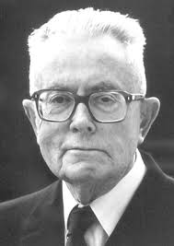
This is the allais ‘paradox’
The Independence Axiom is the crucial part of Expected Utility theory.
Experimental tests of this axiom and others have led to the development of new theories of behaviour under risk, most notably Prospect theory and Rank-Dependent Expected Utility theory.
Allais (Nobel Prize 1988) was an early
experimenter in the field.

Slide 43
How do you set up an experiment to test for the validity of an axiom?
Let us take the independence axiom which states that if a person prefers A to B then he or she should prefer a mixture of A with something else to the same mixture of B with the same something else.
I have already shown you an example.
Is one test with one subject enough?
More subjects, more problems.
How many is enough?

Slide 44
Dynamic choice
Dominated by strong ideas of rationality, particularly that of solving dynamic problems by backward induction (underlies rational expectations).
Consider the following dynamic problem.
In these green squares are decision nodes and red squares are where Nature moves, moving Up or Down with equal probabilities.
The amounts at the end are payoffs.
What would you do at the first decision node?
This is from an experiment of The Three Johns.

Slide 45
Dynamic choice
Economists say that people solve a dynamic problem using backward induction.
Consider the following problem (which I have investigated experimentally – with John Bone and John Suckling).
It is a dynamic decision problem under risk.

Slide 46
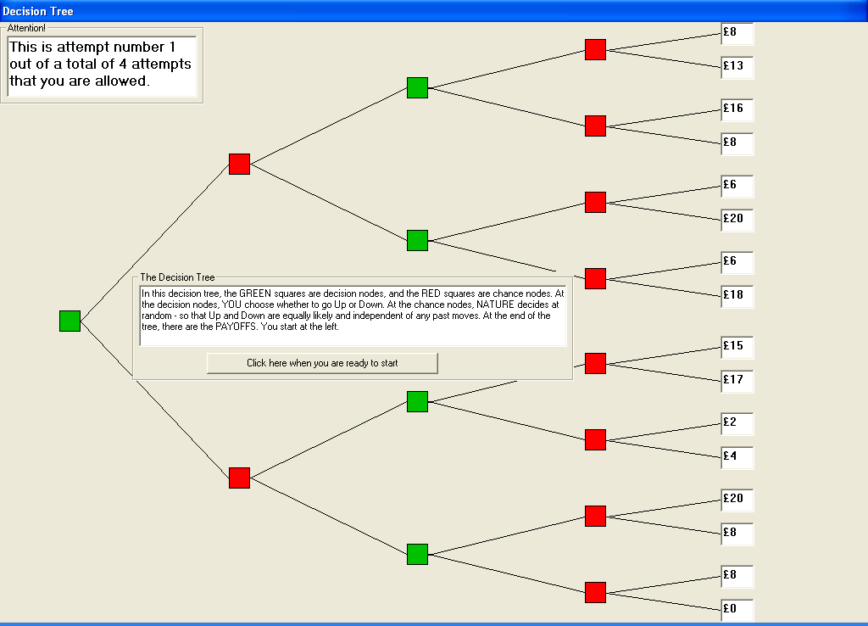

Slide 47
the experimental design
The payoffs in the top half of the tree are
8, 13,16, 8, 6, 20, 6,18
The payoffs in the bottom half of the tree are
15, 17, 2, 4, 29, 8, 8, 0
The ordered payoffs in the top half of the tree are
20, 18, 16, 13, 8, 8, 6, 6
The ordered payoffs in the bottom half of the tree are
20, 17, 15, 8, 8, 4, 2, 0
Top dominates bottom …
… but this ignores the second decision.

Slide 48
the second nodes
The decision maker would choose Down, Up, Up and Down (assuming dominance) therefore eliminating 8, 13, 6, 8, 2, 4, 8 and 0, leaving
16, 8, 6, 20 in the top (ordered 20, 16, 8 and 6) and
15, 17, 20, 8 in the bottom (ordered 20, 17, 15 and 8)
Now bottom dominates top.
The experiment showed that well under half the subjects chose wrongly…
…and even forcing them to pre-commit to the second decision did not push the right choice to over 50%!

Slide 49
What the experiment shows
People do not plan ahead – even in the context of this simple example.
People do not backwardly induct.
What does economists’ theory of saving assume?
… backward induction from the date of death.

Slide 50
savings
Economists, with their life-cycle theory of saving, assume that agents backwardly induct from the date of their death.
How do you do an experiment to test this?
An experiment with a finite number of periods in each of which the agent gets an income in tokens. Savings earn interest. Each period they have to decide how much of their wealth to convert into money – through a conversion scale u(.).
What do such experiments show?
That people under-save in early periods. Myopia?

Slide 51
So what have we learnt?
That spontaneous action can lead to equilibrium.
That equilibrium may not be achieved; that other factors are at play.
That the concepts of rationality used in much of economics are too strong.
People are myopic and do not use backward induction.
Experiments have led to new theories.

Slide 52
what has been learnt elsewhere?
People are different. Interesting?
Cultures are different. Interesting?
The more micro you look the more the differences.
People have noise in their behaviour but are not completely random.
Emotion seems to affect behaviour.
The environment seems to affect behaviour.
If we are interested in aggregate micro behaviour perhaps these differences cancel out?
But the behaviour of the average is not the average of behaviour.

Slide 53
other experiments
I have not mentioned Field Experiments as I do not do them (but Nam Pham has – a very interesting field experiment).
They are experiments carried out ‘in the field’ with perhaps the subjects not knowing that they are in an experiment.
Some experiments are carried out in low-income countries as one can provide higher incentives.

Slide 54
New types of experiments
Effect of gender-inclusive language on decision-making.
Mindful Parenting and Children’s Socio-Emotional Skills and Preferences.
Testing for Ethnic Discrimination in Outpatient Health Care Evidence from a Field Experiment in Germany.
The Right to be Heard: A Randomized Controlled Trial on Economizing Procedural Justice.
Social Preferences and the Transmission of Narratives.
Are Proactive Narratives More Convincing? An Experiment.

Slide 55
What non-experimenters say
“We know that the theory is true.”
Economics is about aggregates not individuals.
Your incentives are not large enough.
These axiomatic violations cancel out.
No comment.
Why are your theories about individuals?
We have tested whether their size makes a difference.
How do you know?

Slide 56
I am also interested in Methodology
Incentives – sufficient?
What one does with the data: describe, test or estimate/predict?
Instructions – test of understanding?
‘Demographic’ Questionnaire?
Computerised/pen and paper?
How to produce ambiguity in the lab? Bingo Blower?

Slide 57
A glimpse of what I have been doing recently (all except the last now published)
Carbone, Hey and Neugebauer: Asset and Forward Markets
Georgalos and Hey: Spontaneous Order
Bayrak and Hey: Dispersion Skewness Theory
Bone Crosetto Hey and Pasca: Social preferences
Hey Permana and Rochanahastin: Testing Manski
Foster, Georgalos and Hey Learning under Ambiguity when Information Acquisition is Costly: an Experiment

Slide 58
Carbone Hey and Neugebauer
Follows Duffy et al in testing the Lucas asset pricing model.
Extends Duffy et al from a oscillating world to a cyclical world.
The asset (which pays a dividend) is used to smooth consumption.
Testing for the equilibrium price which is equal to the expected dividend.
Like Duffy et al substitutes an infinite horizon world with a random horizon (continuation probability = discount factor).
Also we compare this asset market solution to a forward market.
Z-tree double auction.

Slide 59
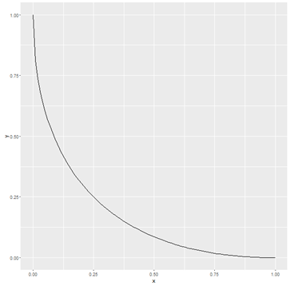
Georgalos and Hey
Testing for the emergence of spontaneous order
We experimentally investigate the emergence of Spontaneous Order -
the idea that societies can co-ordinate, without government intervention, on a form of society that is good for its citizens.
18 subjects in the lab divided into 3’s, with
convex input production possibility frontiers.
Output and payment a function of the total
amounts of the three inputs.
Specialisation crucial.

Slide 60
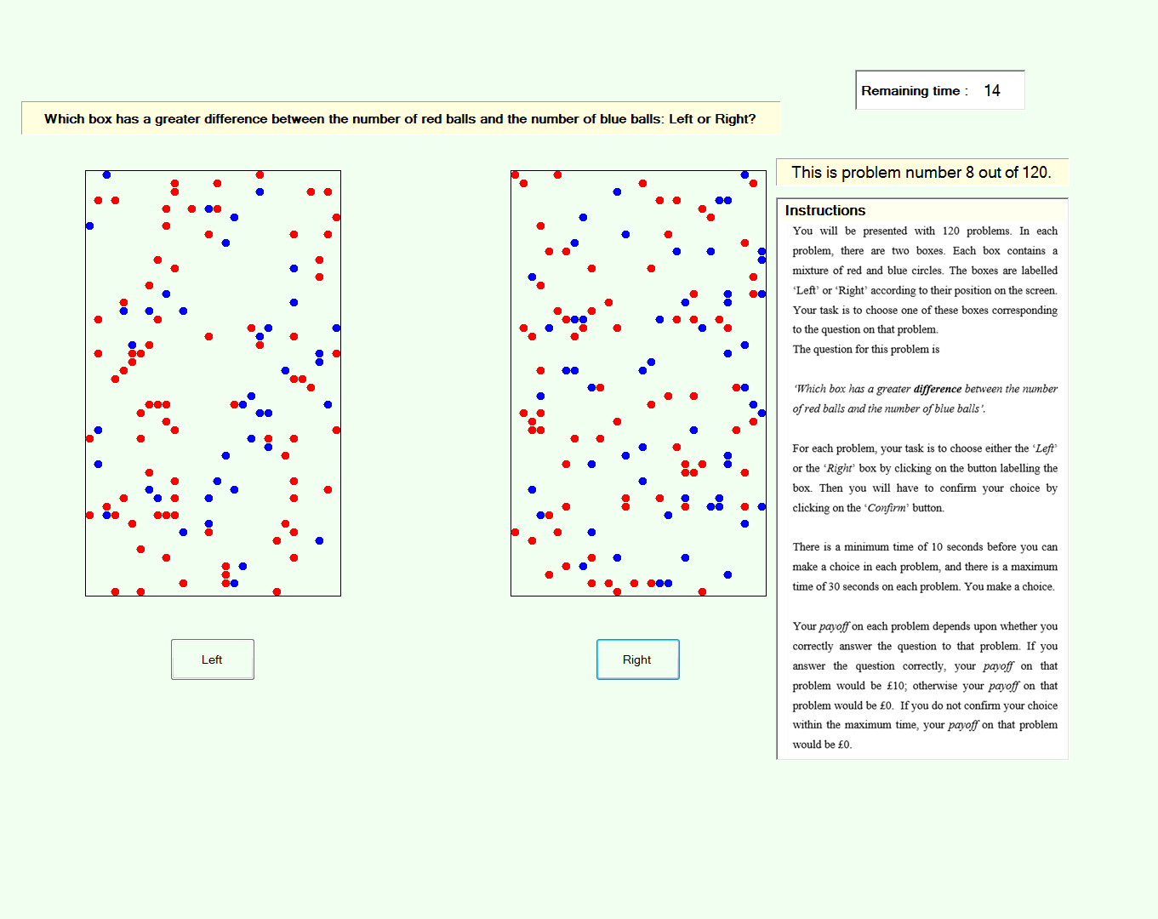
Hey and Rochanahastin
Testing (the axioms of) Salience Theory (Bordallo et al).
Axioms are on Salience – what is that?
(10,70) is more salient than (20,60)
Axiom 3 (MONOTONICITY IN INTERVALS).
For any (𝑥, 𝑦), (𝑥′, 𝑦′) ∈ 𝑋, if [𝑦′, 𝑥′] is a strict subset
of [𝑦, 𝑥] then (𝑥, 𝑦) ⊳𝑠 (𝑥′, 𝑦′).
MONOTONICITY IN RATIOS and (MONOTONICITY IN DIFFERENCES)
Salience theory weighs the difference in probabilities or the
difference in outcomes by their salience.
Axioms are either right or wrong.

Slide 61
Bayrak and Hey
Dispersion-Skewness theory.
Value of a lottery is determined not only by its Expected Utility but also the dispersion and skewness of utility.
Have estimated the theory and compared its goodness-of-fit, and predictive ability, with EU and several other theories (RDEU, DA, PR, WU, ST) using data from an earlier experiment.

Slide 62
Bone Crosetto Hey and Pasca
Testing Social Preferences.
Compensation (via Social Dividends) for Luck and for Effort.
(Some) theory suggests Equal Payment for Luck and Equal Dividend for Effort, but these principles conflict.
Asks for general principles rather than particular cases.
An example: society has 40 to distribute.
Two treatments: Internal and External Dictator
 |  | effort
 |  | none | some
luck | bad | 0 | 6
 | good | 4 | 10
 |  | effort
 |  | none | some
luck | bad | 12 | 18
 | good | 12 | 18

Slide 63
Hey Permana and Rochanahastin
Testing Manski’s theory of satisficing.
DM has to decide between: choosing at random; paying a lot to find out the best; paying less to find out if there are outcomes larger than some (self-stated) ‘aspiration level’.
Crucially DM’s have no idea of the distribution of outcomes: essentially ambiguous between an upper and a lower bound.
We create ambiguity using the method of Stecher et al.
Question – when should the DM satisfice and how should the DM choose the aspiration level?

Slide 64
Rochanahastin
Limited Attention/ Rational Inattention.
The DM chooses from a large set of choices, but may not pay attention to all in the set.
Testing axioms of Lleras et al and Masatlioglu – these are weakenings of WARP.
Inferring preferences from choice. With these theories one can only infer (partial preferences) if the DM violates WARP. (Does the DM have preferences in this case?)

Slide 65
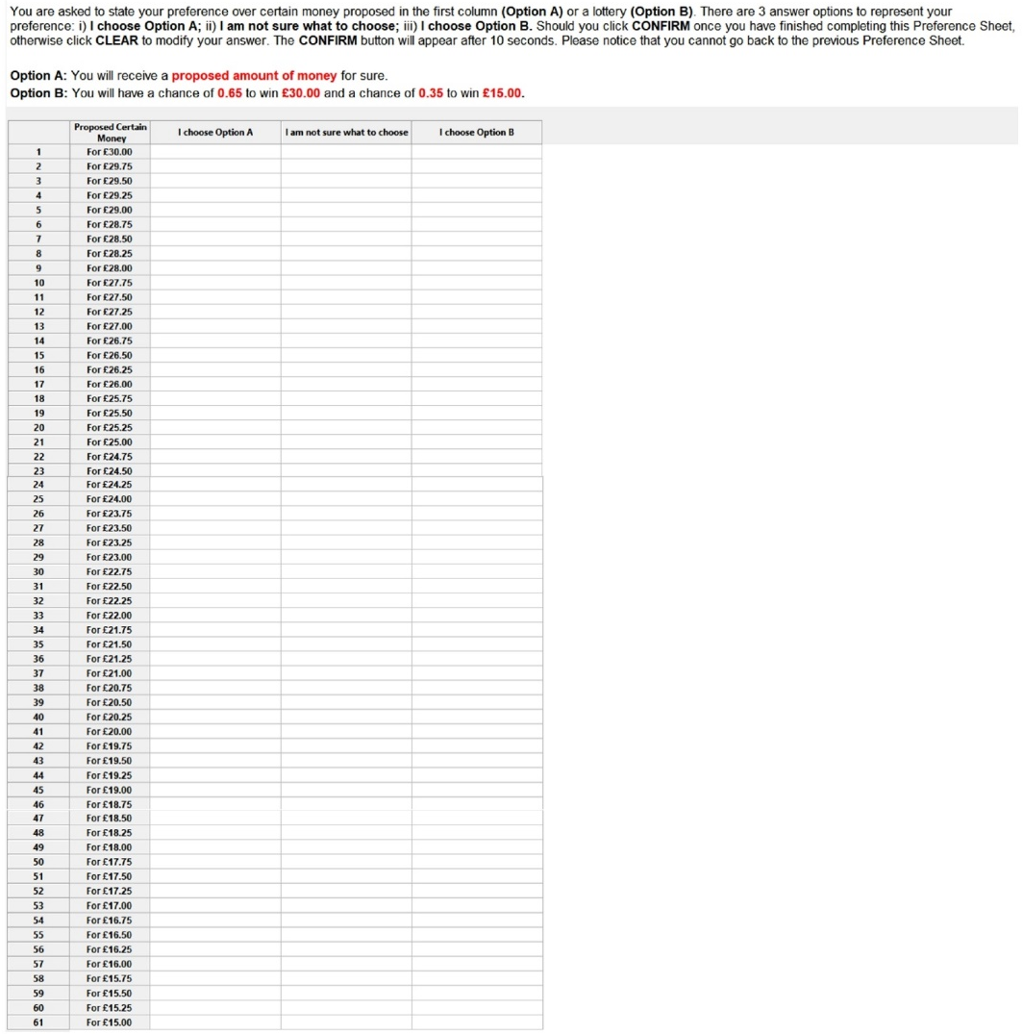
Permana
Preference Imprecision
Builds on Cubitt et al, where subjects could say that
they were not sure what they wanted to choose.
Why did they say that?

Slide 66
Foster, Georgalos and Hey
Testing a theory (by Epstein and Ji) about learning under ambiguity.
There are two urns (both containing 100 balls)
(1) a Risky urn which contains 50 Red and 50 Blue balls
(2) an Ambiguous urn which contains either 90 Red and 10 Blue or 10 Red and 90 Blue.
Subjects have to choose an urn and a colour.
Then a ball is drawn from their chosen urn and if it is the colour that they chose they get paid £20, otherwise £0.
Before choosing they can buy information about the composition of the Ambiguous urn.

Slide 67
What you can do for me
After this lecture, could you send me an email stating:
Your first name
Your last name
Your email address
Your status and background
What your research interests are
Whether you have done experiments and what kind of experiment you are interested in doing.
Any other information that may help me construct this course in the best way for you.

Slide 68
The end
Many thinks for listening.
My thanks to the University of Economics,Ho Chi Minh City for inviting me to give these lectures.

